Slide 1

HEAVEN HOME
TEAM MEMBERS :
1. S.SRIRAM
2. M.AGALAYA
3.G.SRIMATHI
4. M.ASHWAINI
5.K.KAMESHRAJA

Slide 2

List of contents
1.Coding Overview
2.Registration Page
3.Login Page
4.Home Page
5.Services Page
6.About Page
7.Contact Page

Slide 3
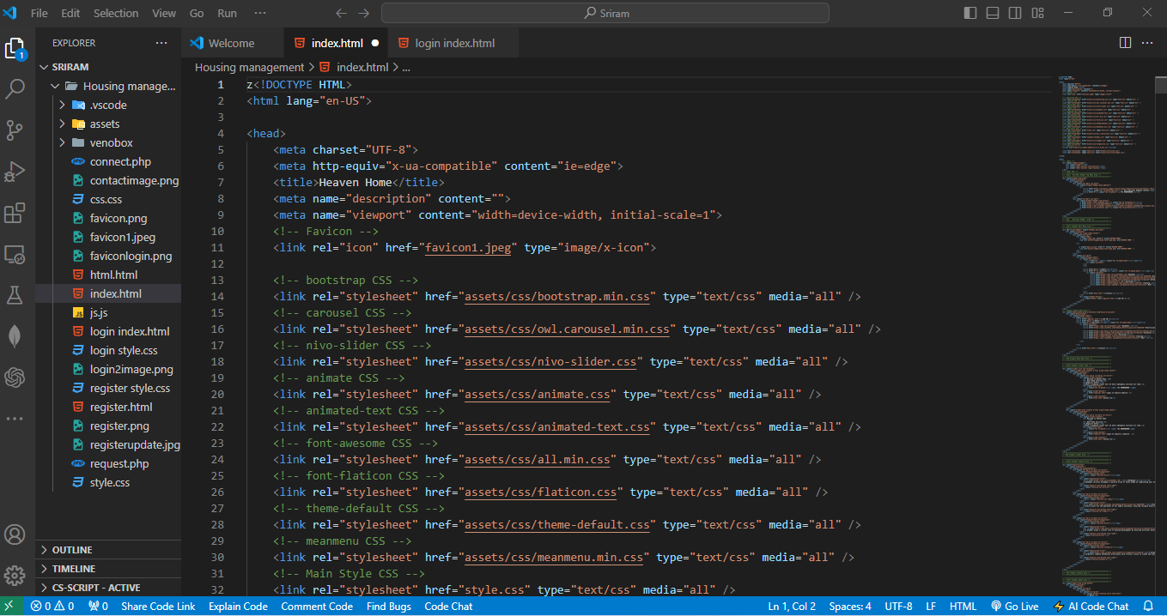
Step 1 : Coding Overview

Slide 4

Step 2 : Registration Page

Slide 5
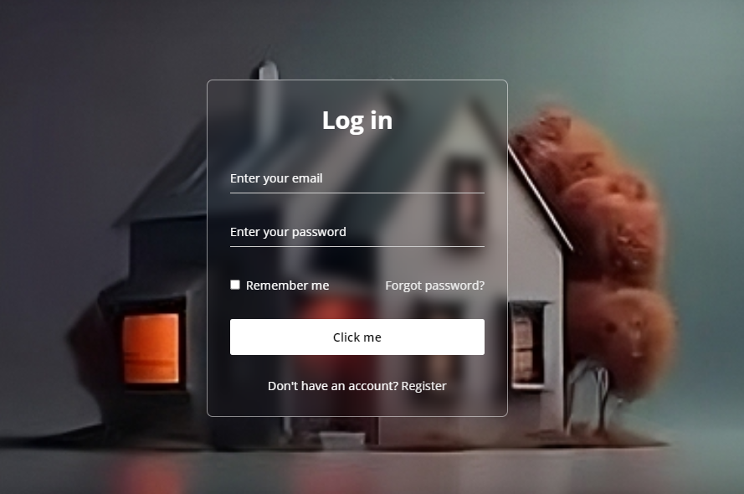
Step 3 : Login Page

Slide 6

Step 4 : Home Page

Slide 7

Step 5: list of Services Page

Slide 8

Handyman Service

Slide 9
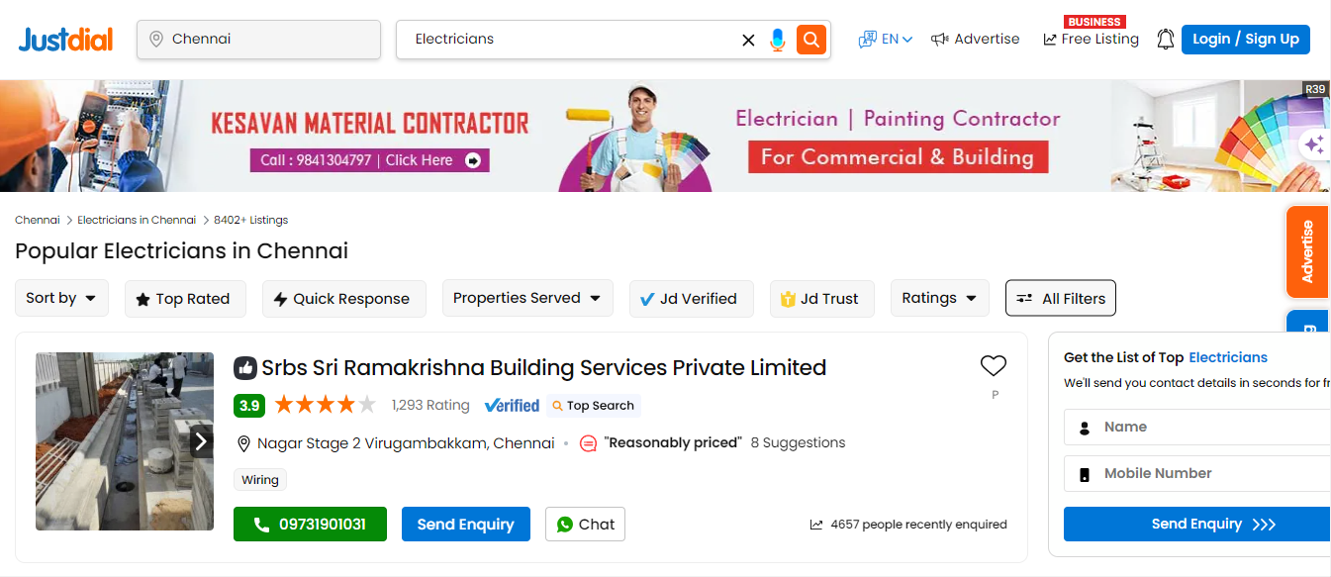
Electrical Service

Slide 10
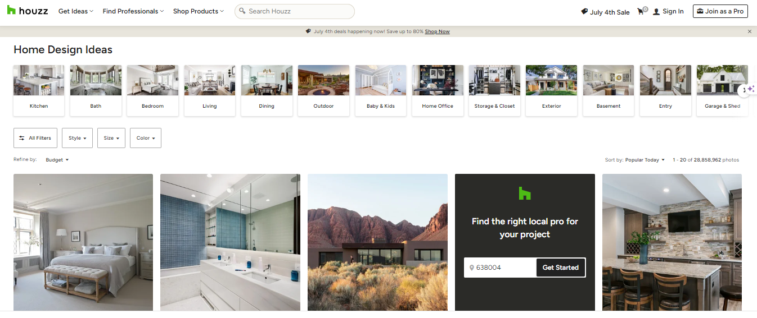
Plumbing service

Slide 11
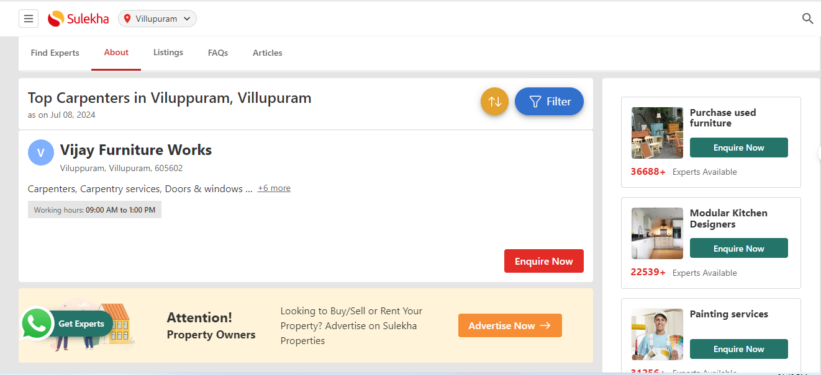
Carpenter Service

Slide 12

Painting Service

Slide 13
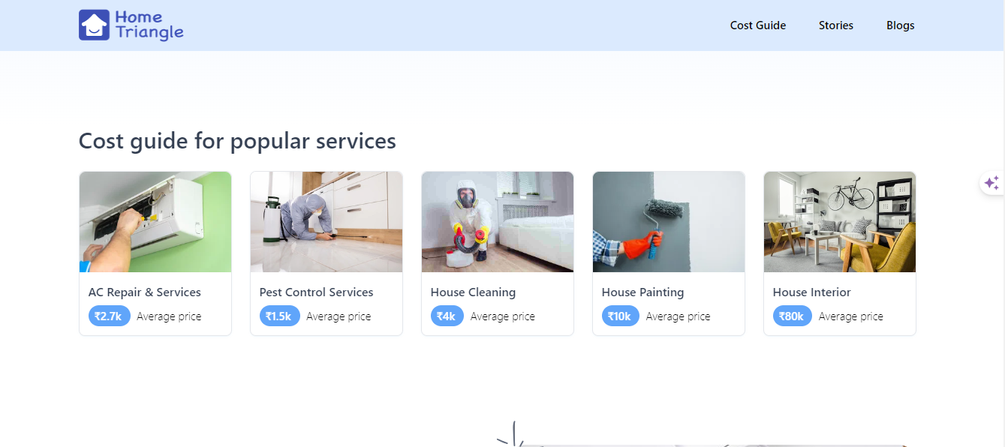
Cleaning service

Slide 14
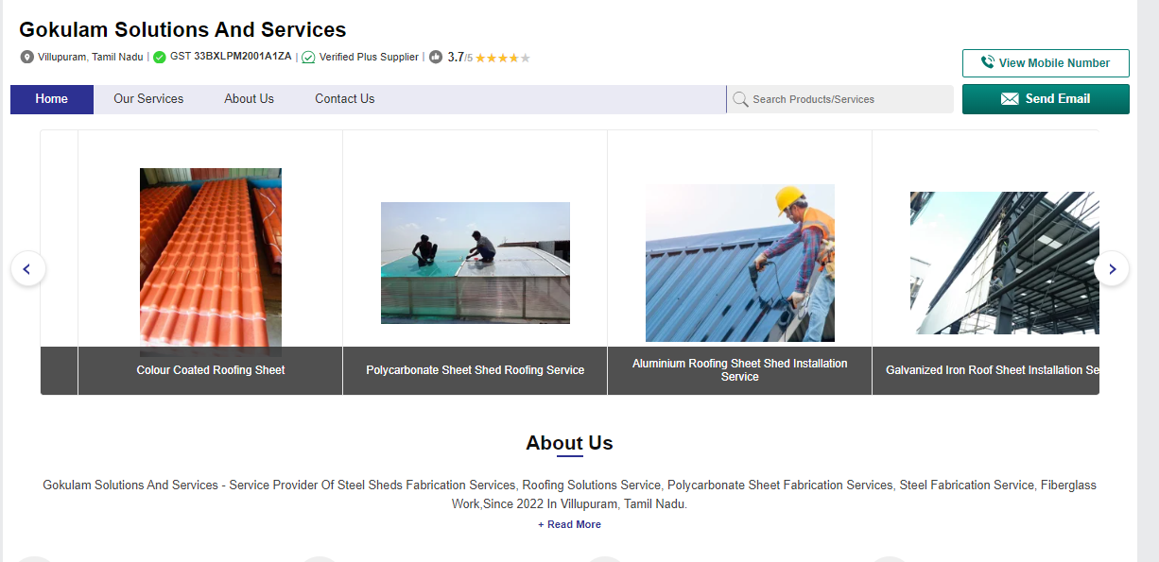
Roof service

Slide 15

About

Slide 16
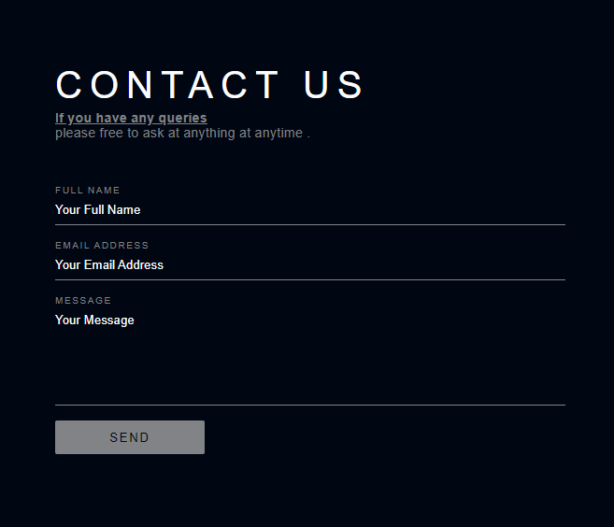

Slide 17

Thank You!

